Slide 1



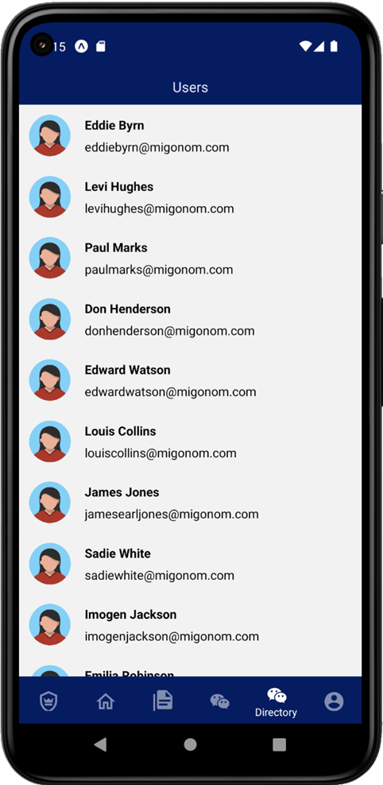
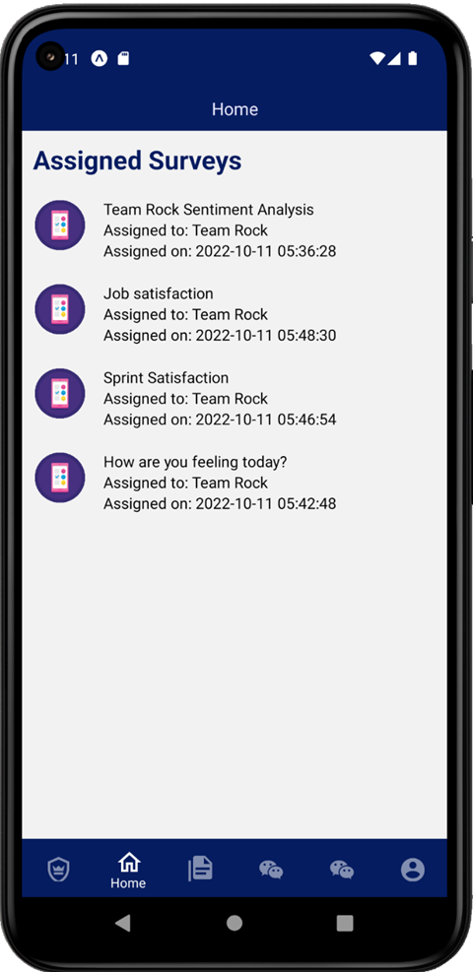
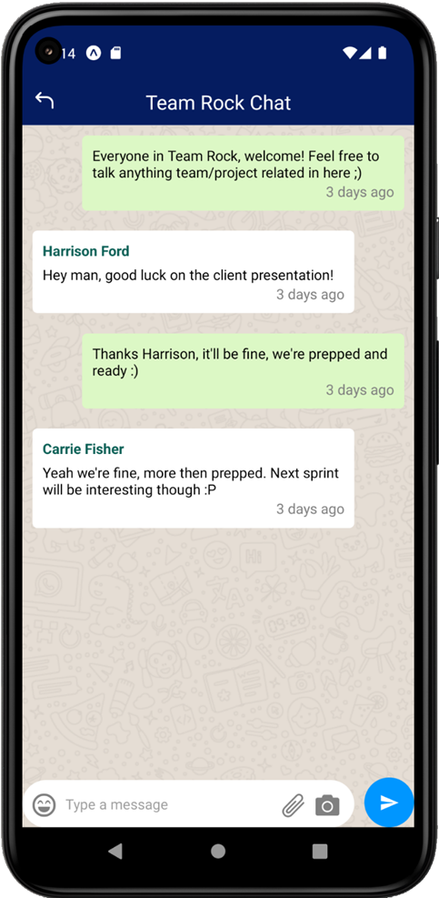
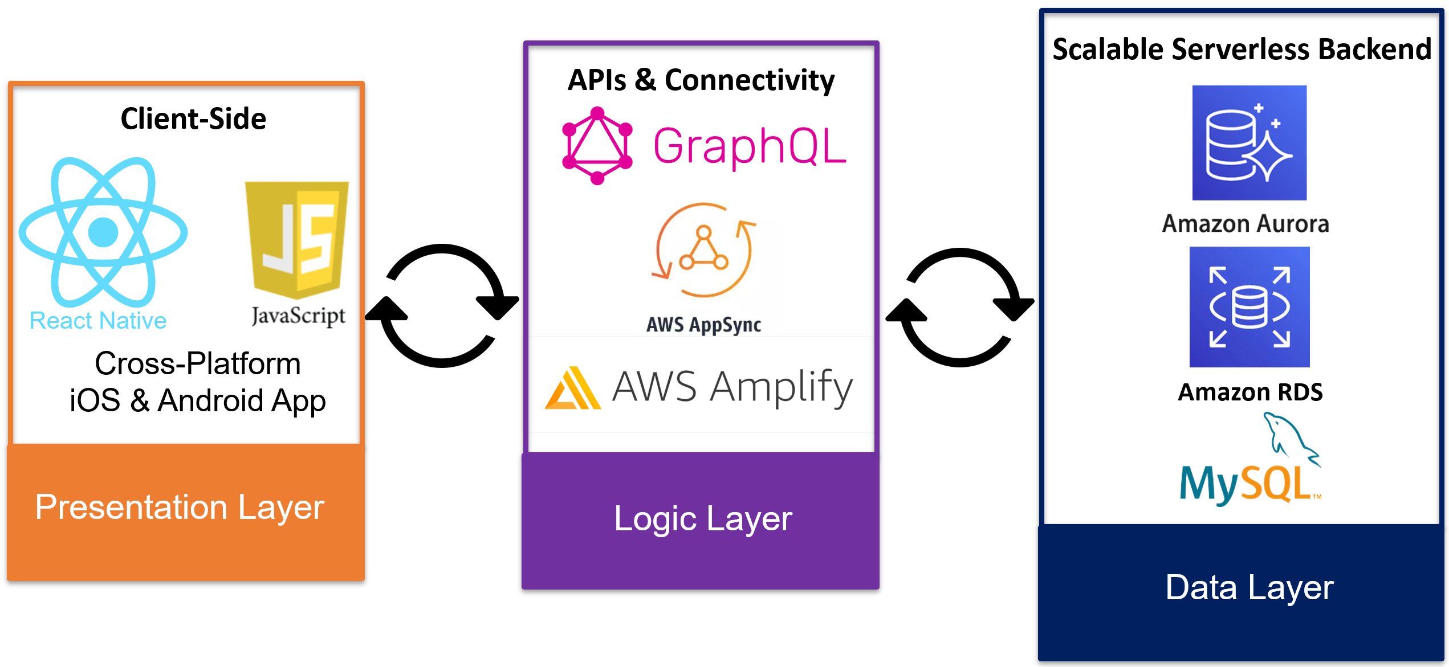
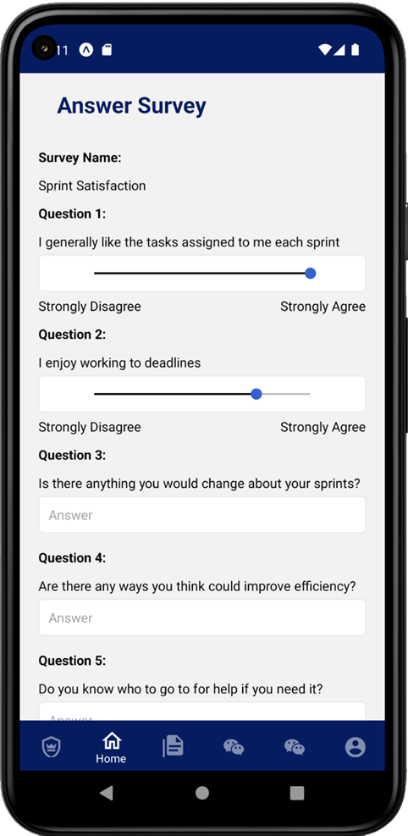
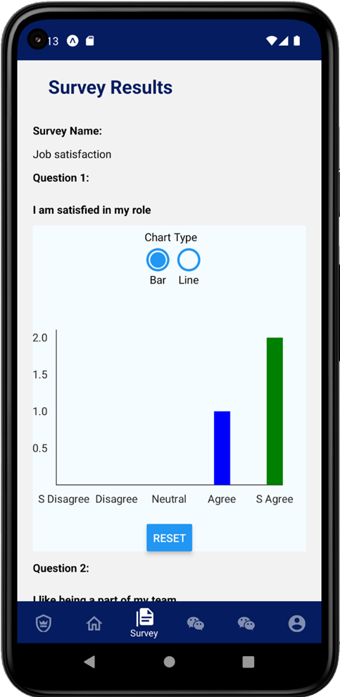



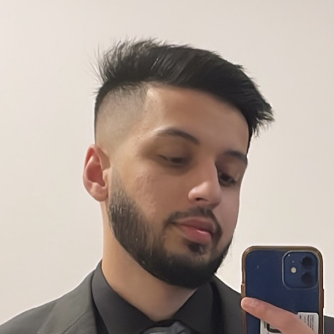


ENGINEERING & IT SHOWCASE
React Native
Project Description
A cross-platform full stack iOS & Android app that allows a company and their employees to create, assign, answer and graphically view the results of custom surveys, communicate through multi-user chat channels, view a directory of registered employees and authenticate securely. The app leverages software as a service and cloud computing by heavily integrating itself with AWS and many of its services.
System Architecture
Team Freeware
James Worcester Backend, API, Frontend (Surveys & Authentication)
Duc Hung Tran Frontend (Chat Channels & Navigation)
Alex McCoy Frontend (Survey Visualisation)
Hamza Shaikh Functional & Usability Testing
Ali Alriyami Frontend

